Slide 1
Unit-I
Data and pre-processing

Slide 2
Outline
Introduction
Data
Category of data
Data and acquisition
Attributes and Objects
Types of Data
Data Quality
Data Preprocessing
Data Mining

Slide 3
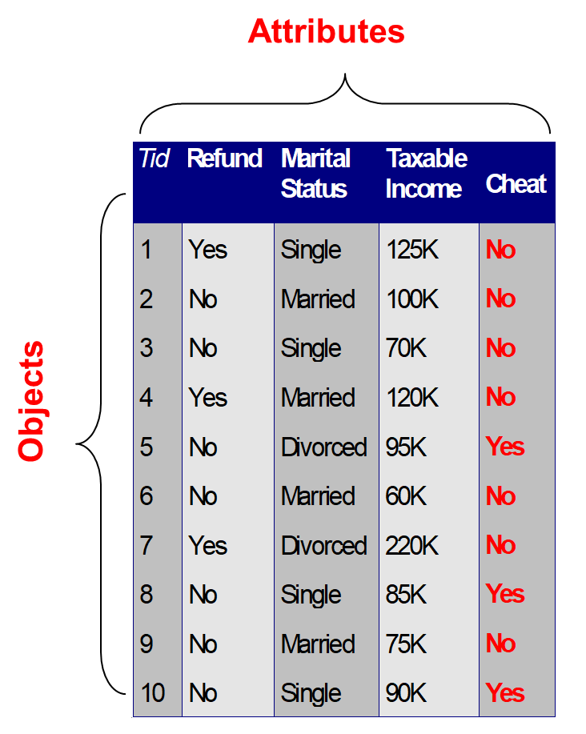
Introduction: Data?
Collection of data objects and their attributes
An attribute is a property or characteristic of an object
Examples: eye color of a person, temperature, etc.
Attribute is also known as variable, field, characteristic, dimension, or feature
A collection of attributes describe an object
Object is also known as record, point, case, sample, entity, or instance

Slide 4
Introduction: Category of Data
Raw facts and figures
Standardized
Structured data
Easily transferable between different information systems.
For example, a students’ name, date of birth, marks, or a blood-test result,
Data
(Raw facts and figures)
Not standardized
Unstructured data
For example: audio recordings, or physician notes about a patient
Semi-structured data
Courtesy: various online sources

Slide 5
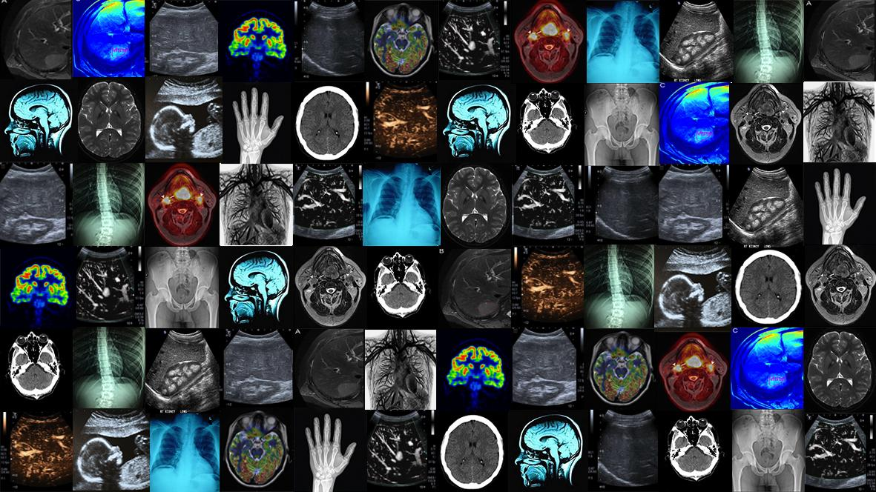
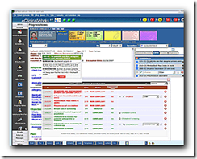
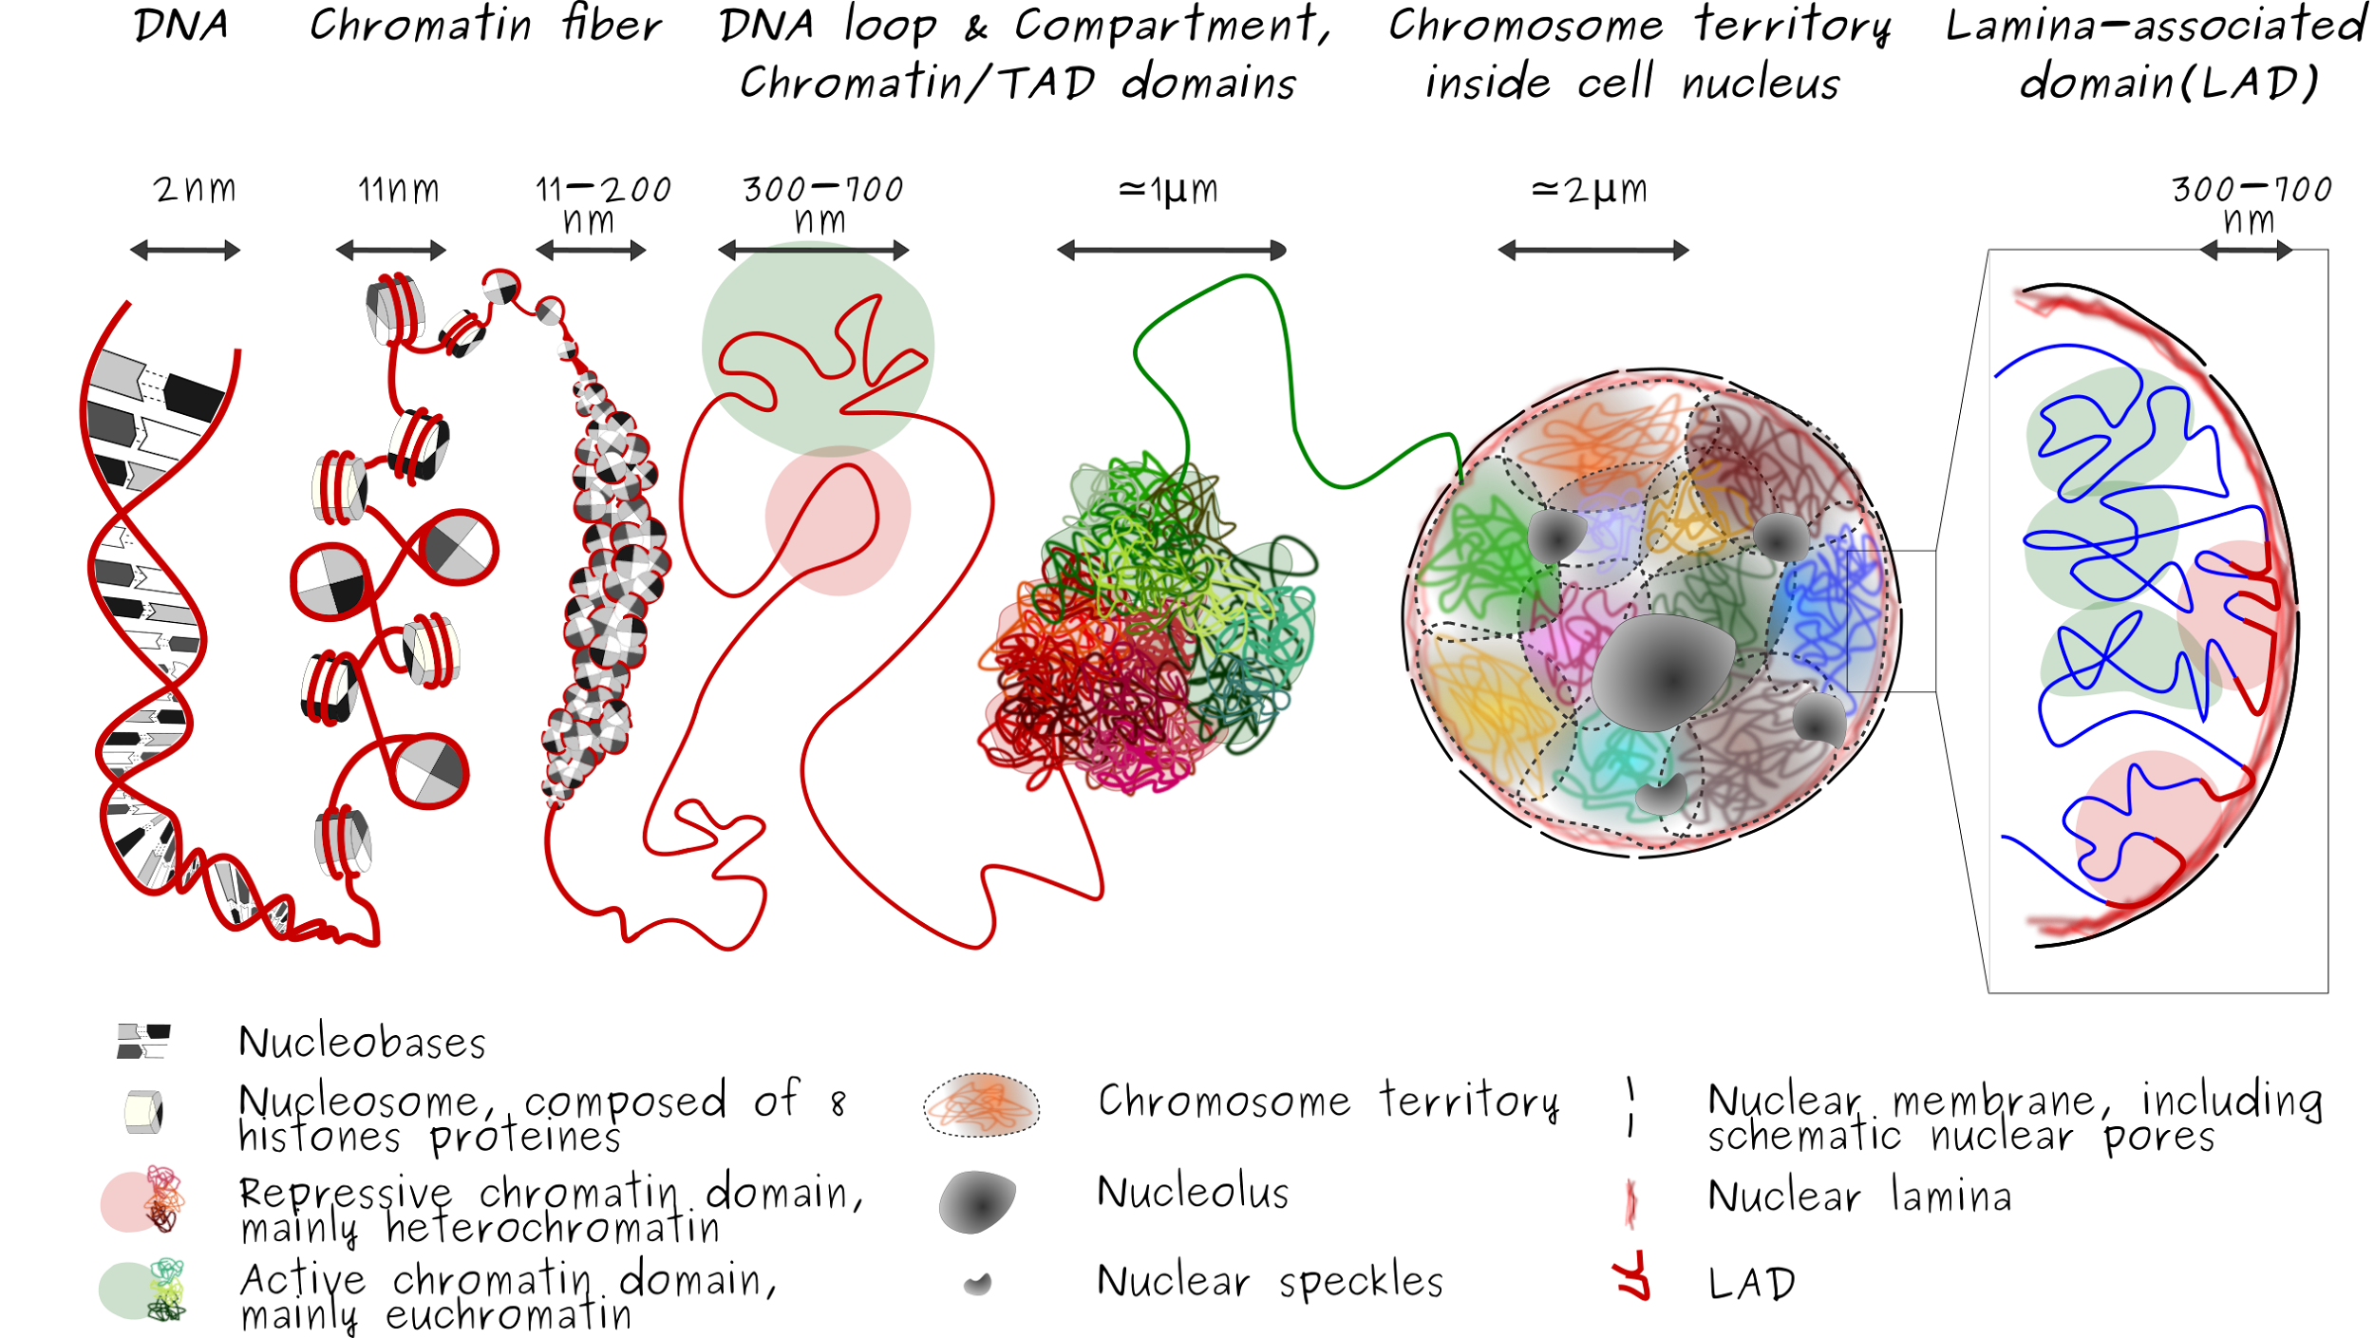
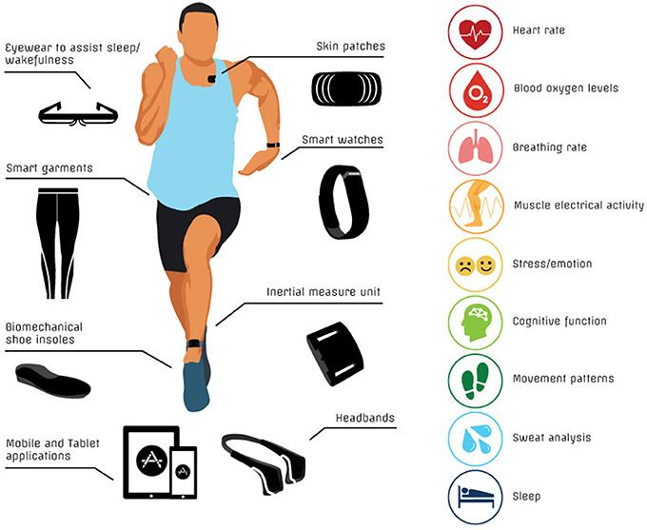

Introduction: Data (Example)
Data in Health
Various types of medical/health data
Electronic Health Records (EHR)
Medical Imaging Data
Genomic Data
Wearable Device Data
Clinical Trials Data
Many more …
This Photo by Unknown Author is licensed under CC BY-ND
This Photo by Unknown Author is licensed under CC BY-SA
This Photo by Unknown Author is licensed under CC BY-SA-NC
This Photo by Unknown Author is licensed under CC BY
Courtesy: various online sources
This Photo by Unknown Author is licensed under CC BY

Slide 6
Types of data sets
Record
Data Matrix
Document Data
Transaction Data
Graph
World Wide Web
Molecular Structures
Ordered
Spatial Data
Temporal Data
Sequential Data
Genetic Sequence Data

Slide 7
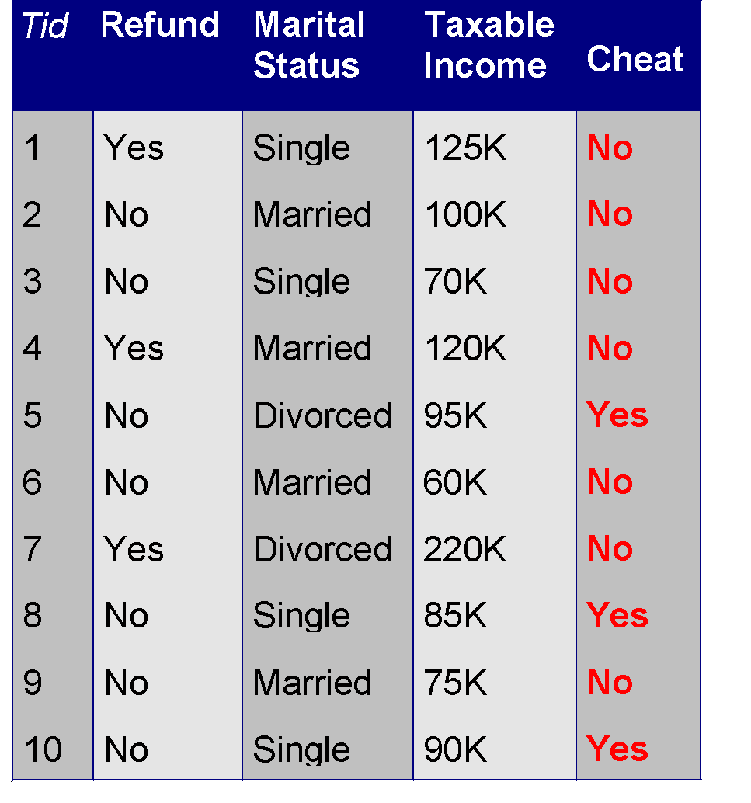
Record Data
Data that consists of a collection of records, each of which consists of a fixed set of attributes

Slide 8
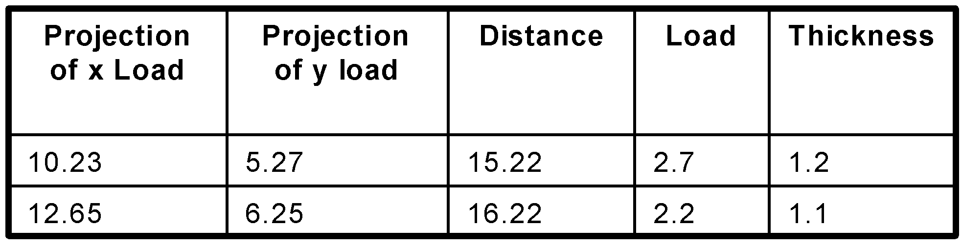
Data Matrix
If data objects have the same fixed set of numeric attributes, then the data objects can be thought of as points in a multi-dimensional space, where each dimension represents a distinct attribute
Such a data set can be represented by an m by n matrix, where there are m rows, one for each object, and n columns, one for each attribute

Slide 9
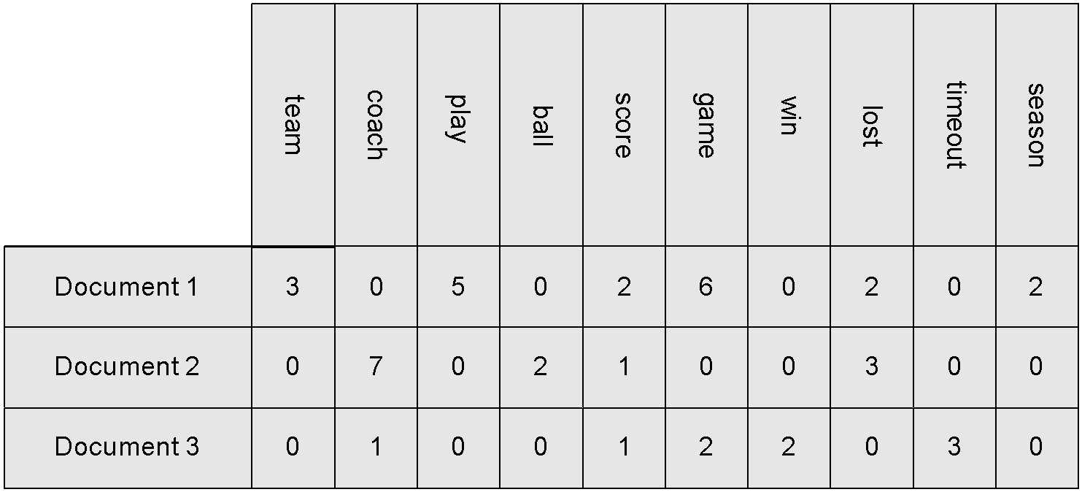
Document Data
Each document becomes a ‘term’ vector
Each term is a component (attribute) of the vector
The value of each component is the number of times the corresponding term occurs in the document.

Slide 10
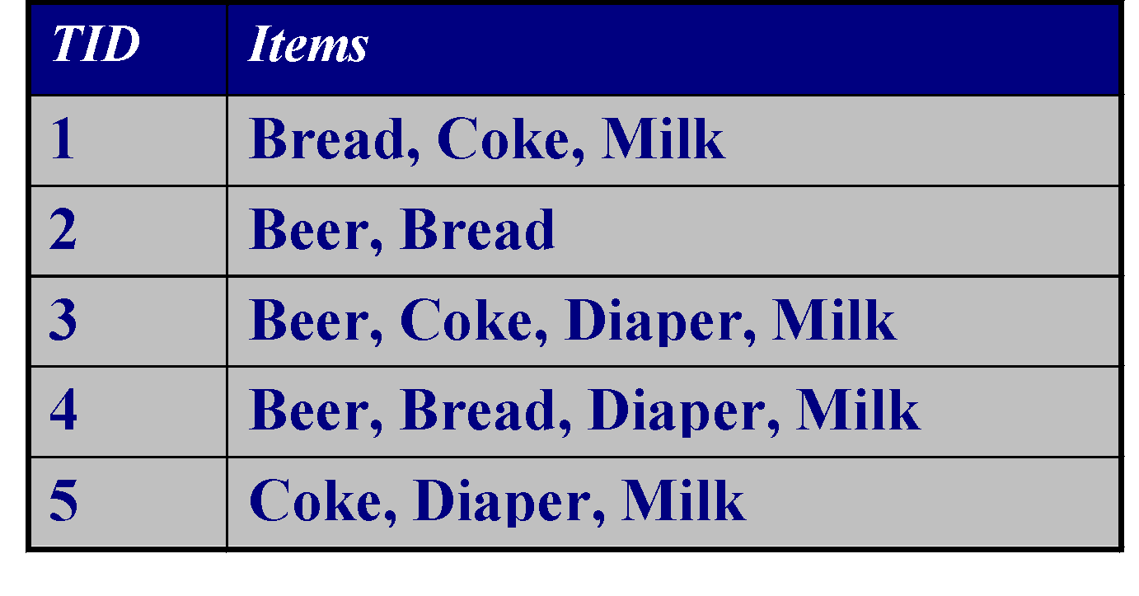
Transaction Data
A special type of data, where
Each transaction involves a set of items.
For example, consider a grocery store. The set of products purchased by a customer during one shopping trip constitute a transaction, while the individual products that were purchased are the items.
Can represent transaction data as record data

Slide 11
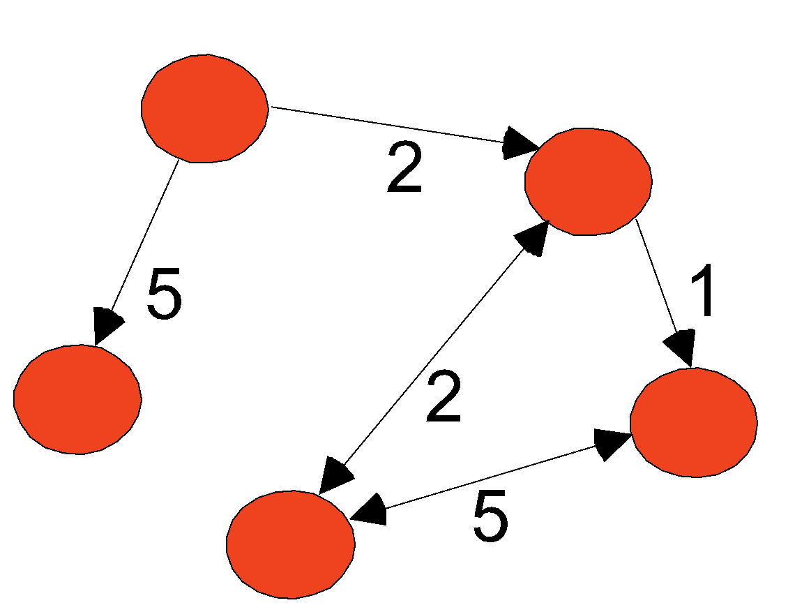
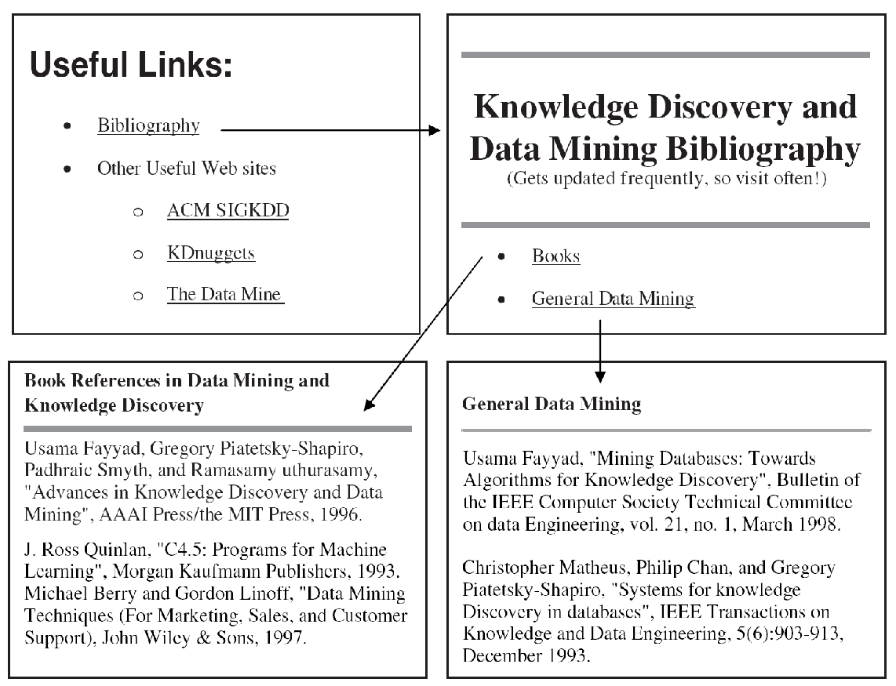
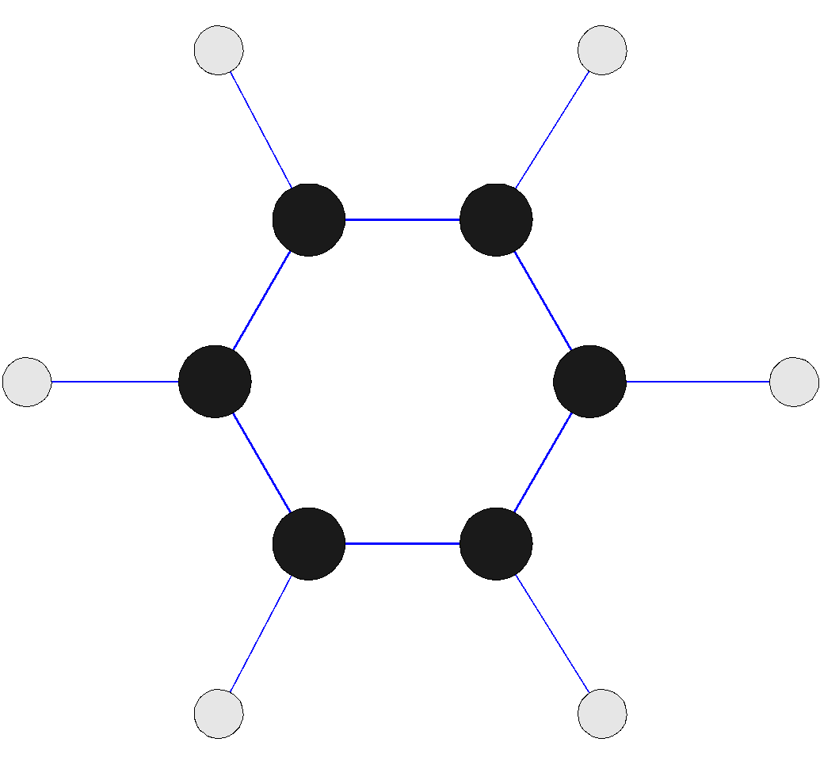
Graph Data
Examples: Generic graph, a molecule, and webpages
Benzene Molecule: C6H6

Slide 12
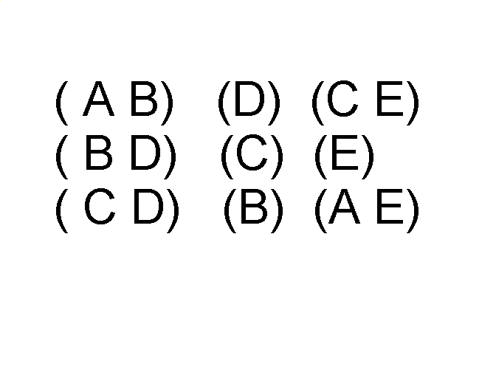
Ordered Data
Sequences of transactions
Items/Events
An element of the sequence

Slide 13
Sequential data
Sequential data refers to data that is arranged or collected in a specific order where the sequence or the order of the data points is significant. This type of data is often encountered in scenarios where the temporal or logical order of events or elements matters.
Key Characteristics of Sequential Data:
Order Matters: The sequence in which the data points appear is crucial. For example, in time series data, the order represents the progression of time.
Temporal Aspect: Often, sequential data involves a time dimension, where each data point is associated with a specific moment or interval.
Dependency: The value of each data point may depend on the previous data points. This is common in sequential patterns, where the outcome or state at one point influences the next.

Slide 14
Examples of Sequential Data:
Time Series Data:
This is one of the most common forms of sequential data. It includes data points indexed in time order, such as stock prices, temperature readings, or daily sales figures. Each data point represents a value at a specific time, and the sequence represents the evolution of that value over time.
Text Data:
In natural language processing (NLP), text is treated as sequential data where each word, character, or sentence follows in a specific order. For example, in a sentence, the order of words determines the meaning, making the sequence critical.
Sensor Data:
Data collected from sensors over time, such as accelerometer readings, heart rate monitors, or environmental sensors, is sequential. The order of readings is important as it reflects changes in the measured phenomenon over time.
Genomic Data:
DNA sequences are another example of sequential data. The order of nucleotides (A, T, C, G) in a DNA strand is crucial as it determines the genetic information.
Log Data:
System or application logs that record events in the order they occur are sequential. These logs are used to trace the sequence of operations, diagnose issues, or analyze behavior over time.
Audio and Video Data:
Audio and video are sequential data types where the order of samples (in audio) or frames (in video) is crucial for maintaining the integrity of the sound or visual content.

Slide 15
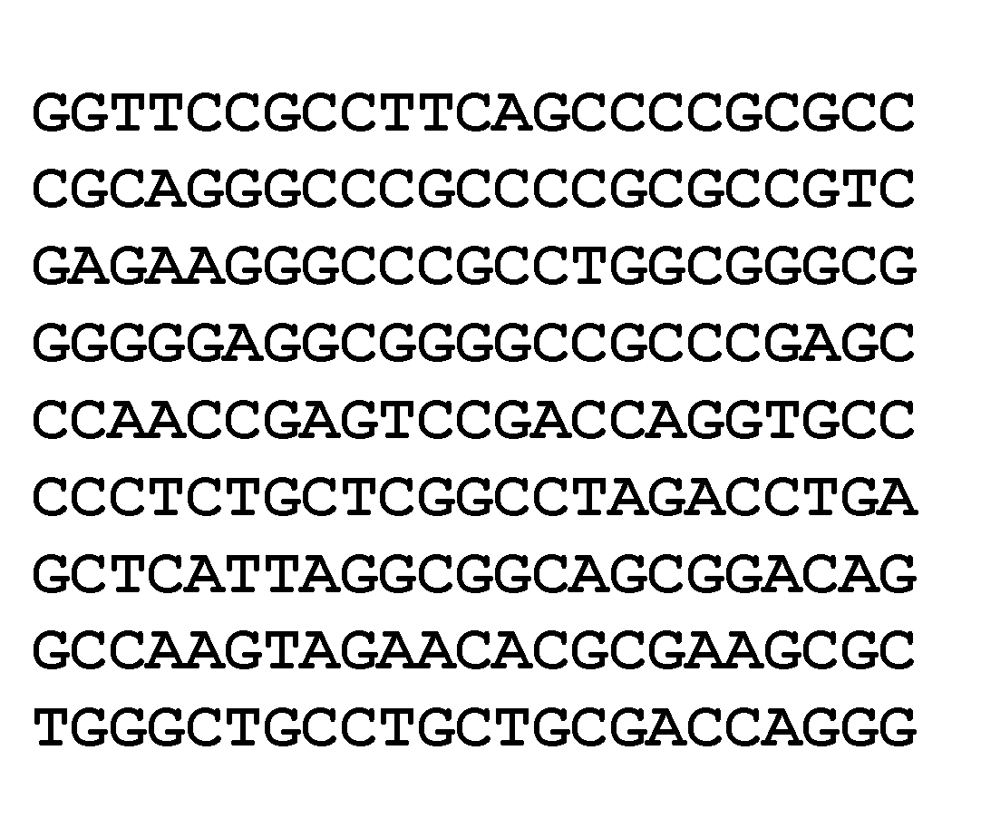
Ordered Data
Genomic sequence data
Here we only see GTCA
This is Genomic sequence

Slide 16
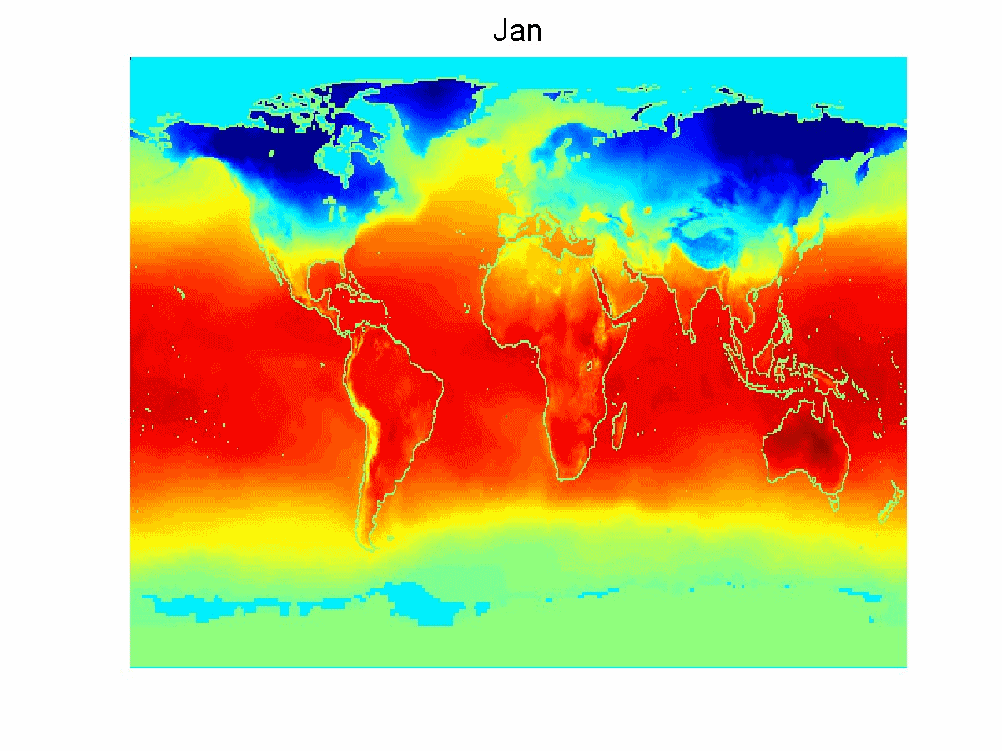
Ordered Data
Spatio-Temporal Data
Average Monthly Temperature of land and ocean

Slide 17
Attribute and Measurement Scale
Attribute
A property or characteristic of an object that may vary, either from one object to another or from one time to another.
Measurement scale
A rule (function) that associates a numerical or symbolic value with an attribute of an object.

Slide 18
Attribute Values
Attribute values are numbers or symbols assigned to an attribute for a particular object
Distinction between attributes and attribute values
Same attribute can be mapped to different attribute values
Example: height can be measured in feet or meters
Different attributes can be mapped to the same set of values
Example: Attribute values for ID and age are integers
But properties of attribute can be different than the properties of the values used to represent the attribute

Slide 19
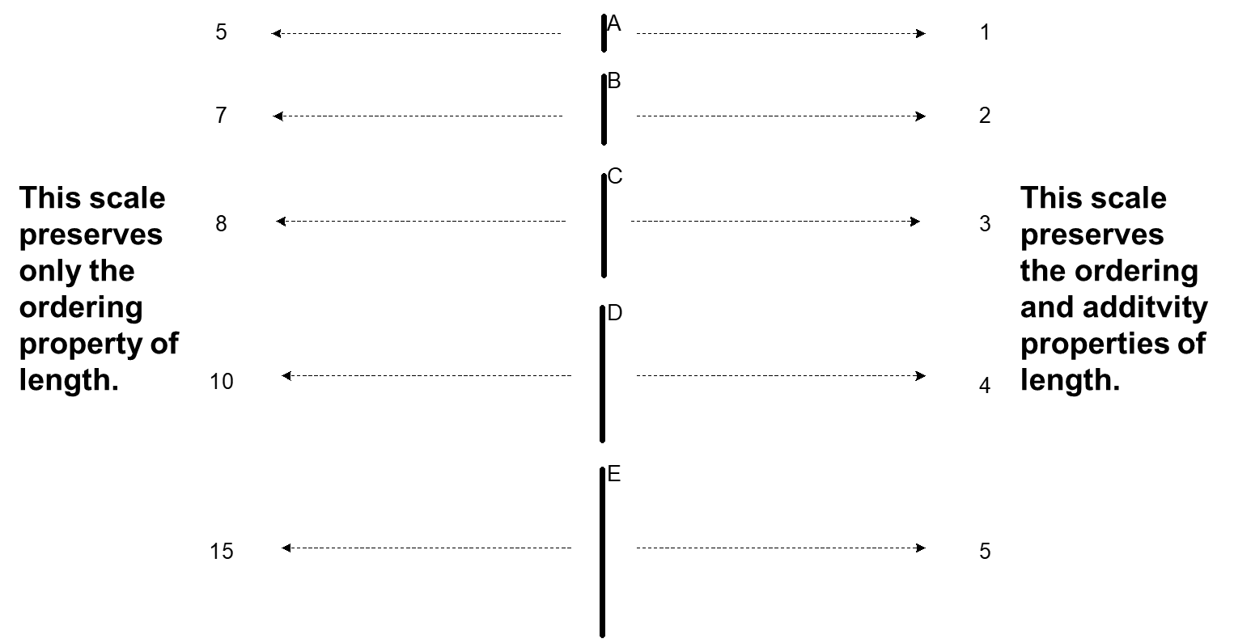
Measurement of Length
The way you measure an attribute may not match the attributes properties.

Slide 20
Types of Attributes
There are different types of attributes
Nominal
Examples: ID numbers, eye color, zip codes
Ordinal
Examples: rankings (e.g., taste of potato chips on a scale from 1-10), grades, height {tall, medium, short}
Interval
Examples: calendar dates, temperatures in Celsius or Fahrenheit.
Ratio
Examples: temperature in Kelvin, length, counts, elapsed time (e.g., time to run a race)

Slide 21
Properties of Attribute Values
The type of an attribute depends on which of the following properties/operations it possesses:
Distinctness: = ≠
Order: < >
Differences are meaningful : + -
Ratios are meaningful: * /
Nominal attribute: distinctness
Ordinal attribute: distinctness & order
Interval attribute: distinctness, order & meaningful differences
Ratio attribute: all 4 properties/operations

Slide 22
Difference Between Ratio and Interval
Is it physically meaningful to say that a temperature of 10 ° is twice that of 5° on
the Celsius scale?
the Fahrenheit scale?
the Kelvin scale?
Consider measuring the height above average
If Bill’s height is three inches above average and Bob’s height is six inches above average, then would we say that Bob is twice as tall as Bill?
Is this situation analogous to that of temperature?
NO because it is relative temperature 0° to 100°
NO because it is relative temperature 32°F to 212°F
Yes because it is absolute temperature 0K to 273.15K

Slide 23
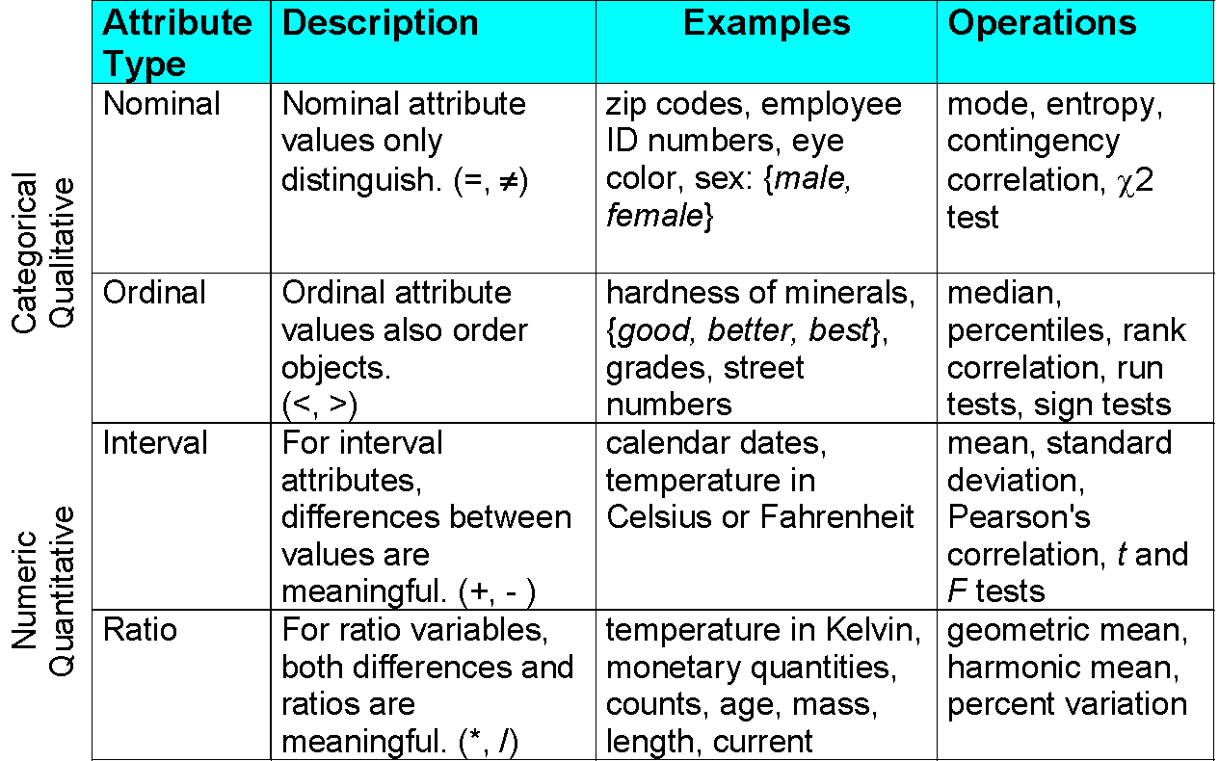
This categorization of attributes is due to S. S. Stevens

Slide 24
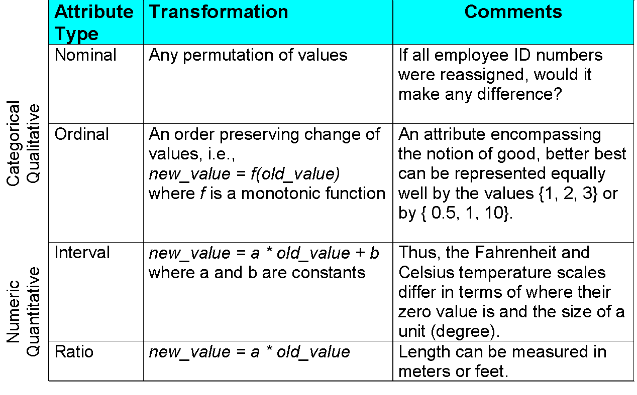
This categorization of attributes is due to S. S. Stevens

Slide 25
Discrete and Continuous Attributes
Discrete Attribute
Has only a finite or countably infinite set of values
Examples: zip codes, counts, or the set of words in a collection of documents
Often represented as integer variables.
Note: binary attributes are a special case of discrete attributes
Continuous Attribute
Has real numbers as attribute values
Examples: temperature, height, or weight.
Practically, real values can only be measured and represented using a finite number of digits.
Continuous attributes are typically represented as floating-point variables.

Slide 26
Asymmetric Attributes
Only presence (a non-zero attribute value) is regarded as important
Words present in documents
Items present in customer transactions
If we met a friend in the grocery store would we ever say the following?
“I see our purchases are very similar since we didn’t buy most of the same things.”

Slide 27
Critiques of the attribute categorization
Incomplete
Asymmetric binary
Cyclical
Multivariate
Partially ordered
Partial membership
Relationships between the data
Real data is approximate and noisy
This can complicate recognition of the proper attribute type
Treating one attribute type as another may be approximately correct

Slide 28
Key Messages for Attribute Types
The types of operations you choose should be “meaningful” for the type of data you have
Distinctness, order, meaningful intervals, and meaningful ratios are only four (among many possible) properties of data
The data type you see – often numbers or strings – may not capture all the properties or may suggest properties that are not present
Analysis may depend on these other properties of the data
Many statistical analyses depend only on the distribution
In the end, what is meaningful can be specific to domain

Slide 29
Important Characteristics of Data
Dimensionality (number of attributes)
High dimensional data brings a number of challenges
Sparsity
Only presence counts
When there are more null values in data
eg :-sparse matrix , adjMatrix
Resolution
Patterns depend on the scale
Size
Type of analysis may depend on size of data

Slide 30
Data Quality
Poor data quality negatively affects many data processing efforts
What kinds of data quality problems?
How can we detect problems with the data?
What can we do about these problems?
Examples of data quality problems:
Noise and outliers
Wrong data
Fake data
Missing values
Duplicate data
The first step, detection and correction, is often called data cleaning.

Slide 31
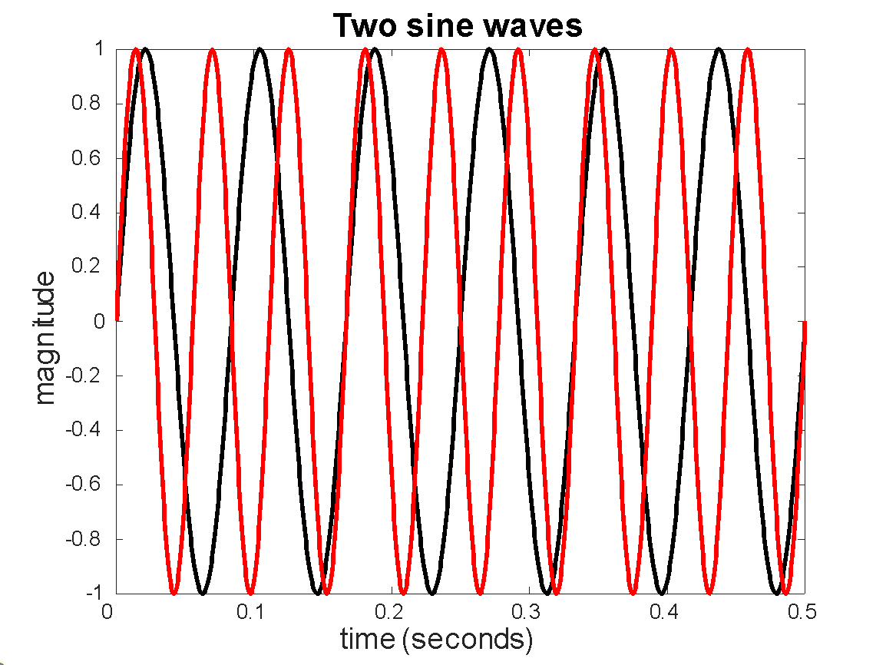
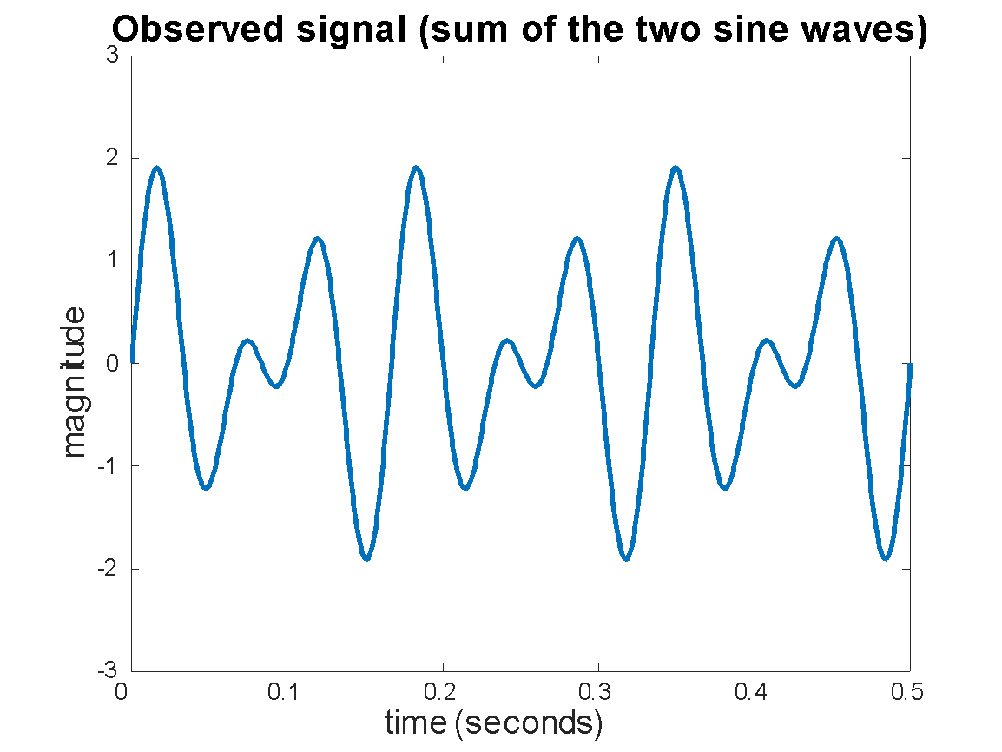
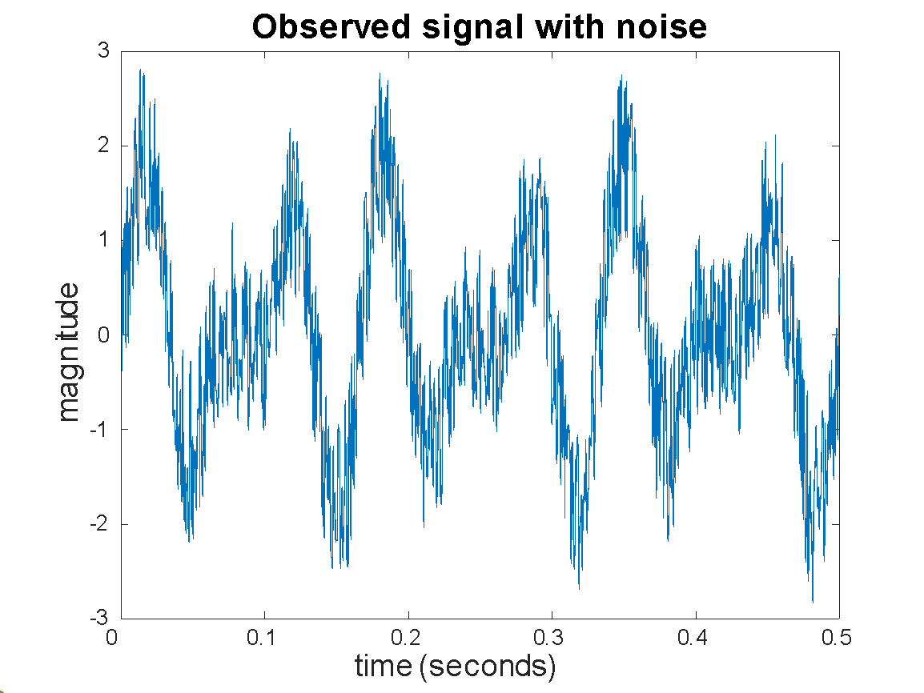
Noise
For objects, noise is an extraneous object
For attributes, noise refers to modification of original values
Examples: distortion of a person’s voice when talking on a poor phone and “snow” on television screen
The figures below show two sine waves of the same magnitude and different frequencies, the waves combined, and the two sine waves with random noise
The magnitude and shape of the original signal is distorted

Slide 32

Outliers
Outliers are data objects with characteristics that are considerably different than most of the other data objects in the data set
Case 1: Outliers are noise that interferes with data analysis
Case 2: Outliers are the goal of our analysis
Credit card fraud
Intrusion detection
Causes?

Slide 33
Missing Values
Reasons for missing values
Information is not collected (e.g., people decline to give their age and weight)
Attributes may not be applicable to all cases (e.g., annual income is not applicable to children)
Handling missing values
Eliminate data objects or variables
Estimate missing values
Example: time series of temperature
Example: census results
Ignore the missing value during analysis

Slide 34
Duplicate Data
Data set may include data objects that are duplicates, or almost duplicates of one another
Major issue when merging data from heterogeneous sources
Examples:
Same person with multiple email addresses
Data cleaning
Process of dealing with duplicate data issues
When should duplicate data not be removed?

Slide 35
Data Preprocessing
Aggregation
Sampling
Discretization and Binarization
Attribute Transformation
Dimensionality Reduction
Feature subset selection
Feature creation

Slide 36
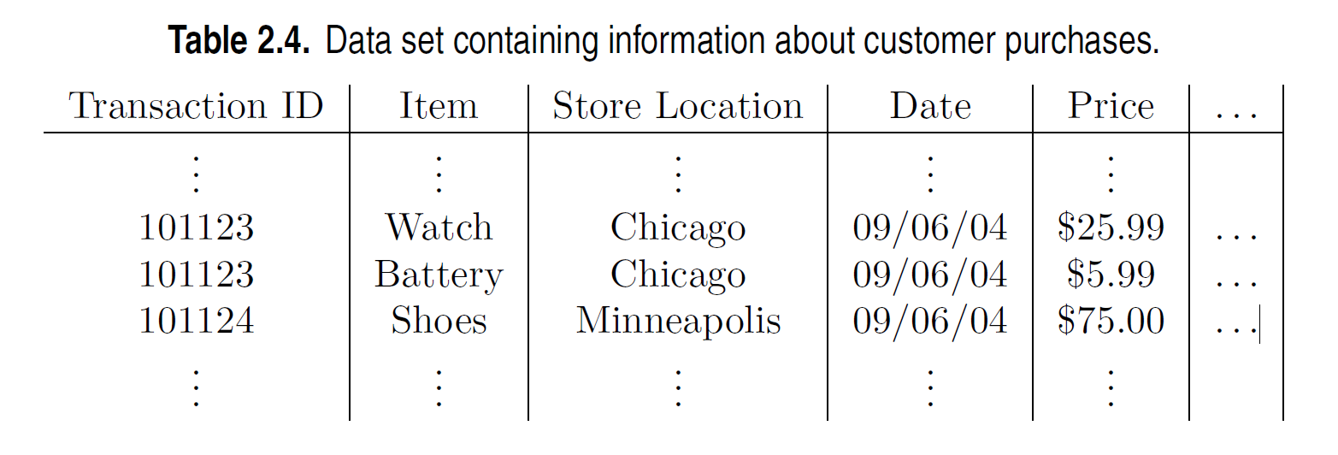
Aggregation
Combining two or more attributes (or objects) into a single attribute (or object)
Purpose
Data reduction - reduce the number of attributes or objects
Change of scale
Cities aggregated into regions, states, countries, etc.
Days aggregated into weeks, months, or years
More “stable” data - aggregated data tends to have less variability

Slide 37
Example: Precipitation in Australia
This example is based on precipitation in Australia from the period 1982 to 1993.
The next slide shows
A histogram for the standard deviation of average monthly precipitation for 3,030 0.5◦ by 0.5◦ grid cells in Australia, and
A histogram for the standard deviation of the average yearly precipitation for the same locations.
The average yearly precipitation has less variability than the average monthly precipitation.
All precipitation measurements (and their standard deviations) are in centimeters.

Slide 38
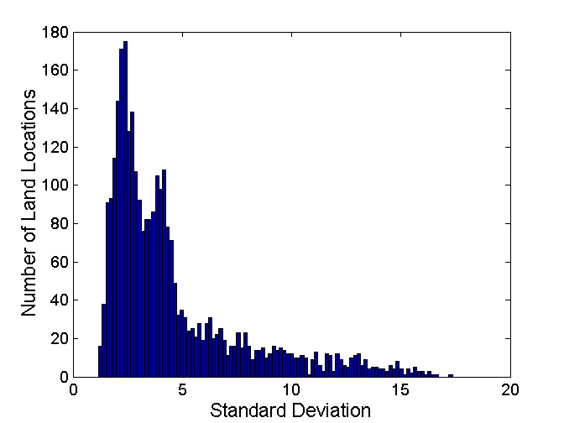
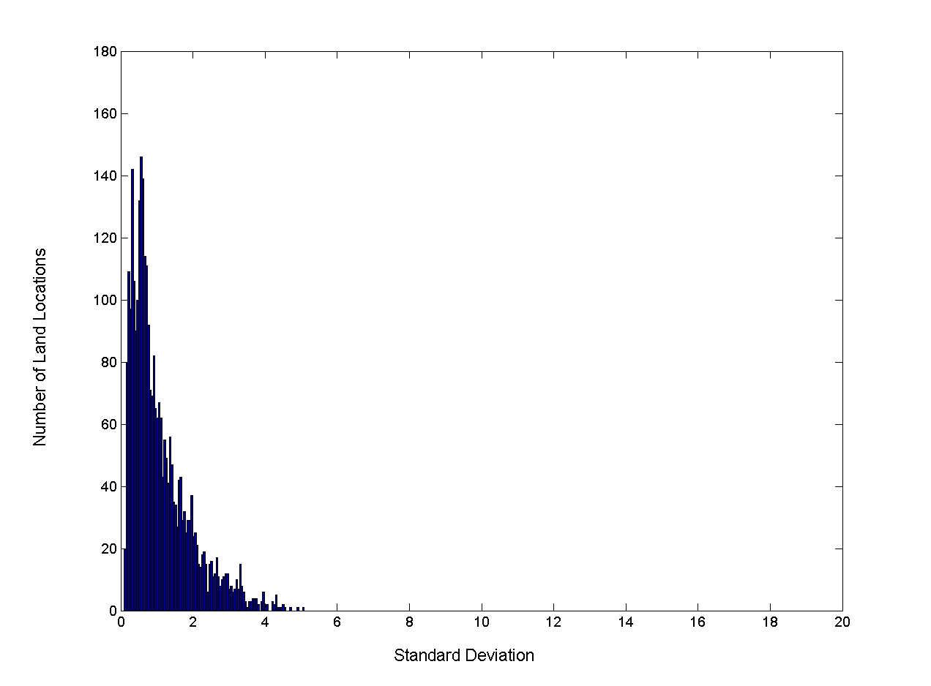
Example: Precipitation in Australia …
Variation of Precipitation in Australia
Standard Deviation of Average Monthly Precipitation
Standard Deviation of Average Yearly Precipitation

Slide 39
Sampling
Sampling is the main technique employed for data reduction.
It is often used for both the preliminary investigation of the data and the final data analysis.
Statisticians often sample because obtaining the entire set of data of interest is too expensive or time consuming.
Sampling is typically used in data mining because processing the entire set of data of interest is too expensive or time consuming.

Slide 40
Sampling …
The key principle for effective sampling is the following:
Using a sample will work almost as well as using the entire data set, if the sample is representative
A sample is representative if it has approximately the same properties (of interest) as the original set of data

Slide 41

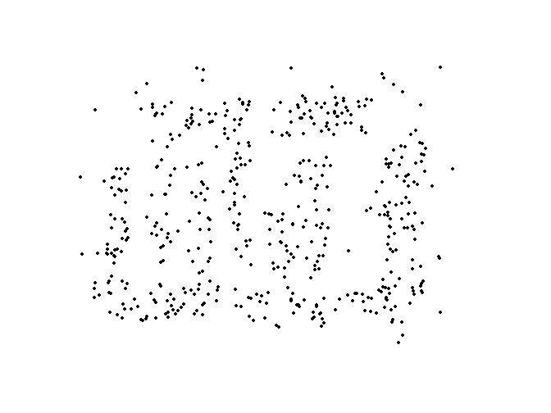
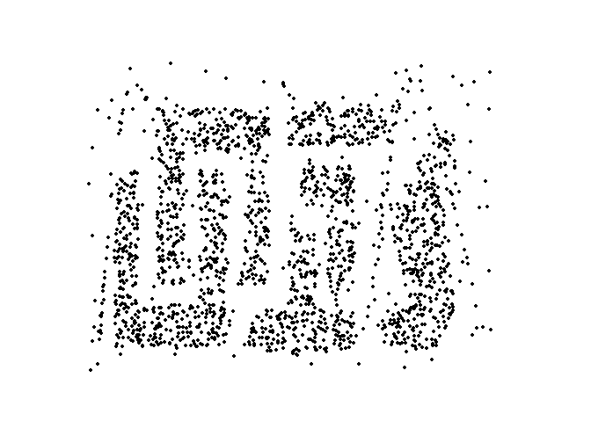
Sample Size
8000 points 2000 Points 500 Points

Slide 42
Types of Sampling
Simple Random Sampling
There is an equal probability of selecting any particular item
Sampling without replacement
As each item is selected, it is removed from the population
Sampling with replacement
Objects are not removed from the population as they are selected for the sample.
In sampling with replacement, the same object can be picked up more than once
Stratified sampling
Split the data into several partitions; then draw random samples from each partition

Slide 43
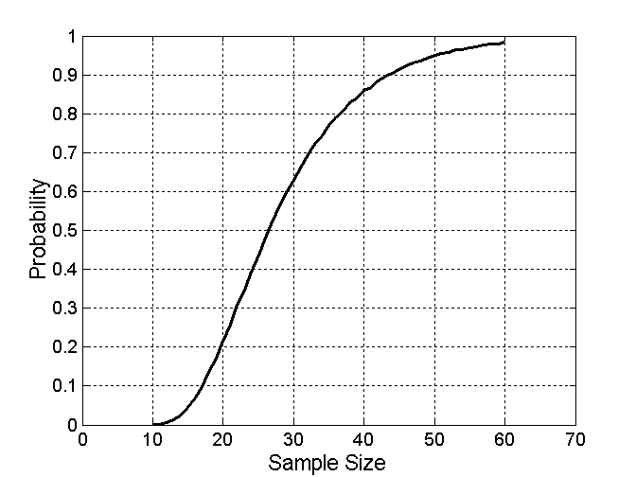
Sample Size
What sample size is necessary to get at least one object from each of 10 equal-sized groups.

Slide 44
Basic Idea: The basic idea is that the probability of not selecting an object from each of the groups decreases as the sample size increases. The expected number of samples required to get at least one item from each of the 10 groups can be calculated using the following formula:
E(n)=n×H_{n}
Hn​ is the n-th harmonic number:
Hn=∑^{n}_{k=1} =1/k
For 10 groups:
E(10)=10×H₁₀
​Harmonic Number Calculation:
For n=10 the harmonic number is:
H₁₀=1+1/2+1/3+…+1/10≈2.92897
So,the expected number of samples E(10) is:
E(10)≈10×2.92897=29.2897
So, on average, about 29 to 30 samples are required to ensure that you get at least one object from each of the 10 groups.

Slide 45
Discretization
Discretization is the process of converting a continuous attribute into an ordinal attribute
A potentially infinite number of values are mapped into a small number of categories
Discretization is used in both unsupervised and supervised settings
In the first step,
the values of the continuous attribute are sorted,
they are then divided into n intervals by specifying n - 1 split points.
In the second,
all the values in one interval are mapped to the same categorical value.
The result can be represented either as a set of intervals {(x0, x1], (x1, x2], . . . , (xn-1, xn)}, where x0 and xn may be +∞ or -∞, respectively, or equivalently, as a series of inequalities x0 < x ≤ x1, . . . , xn-1 < x < xn

Slide 46
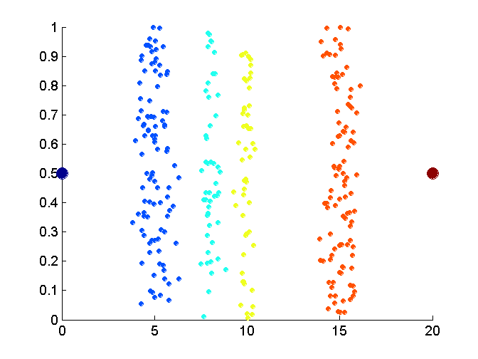
Unsupervised Discretization
Data consists of four groups of points and two outliers. Data is one-dimensional, but a random y component is added to reduce overlap.

Slide 47
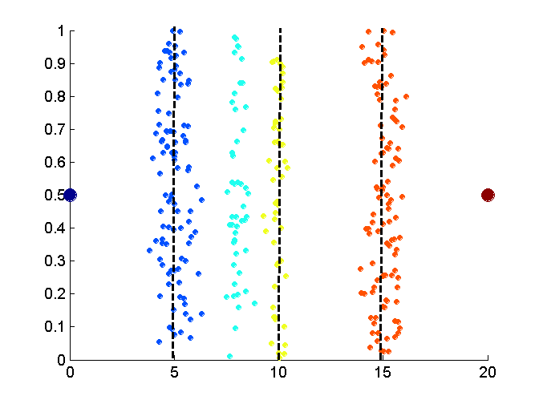
Unsupervised Discretization
Equal interval width approach used to obtain 4 values.

Slide 48
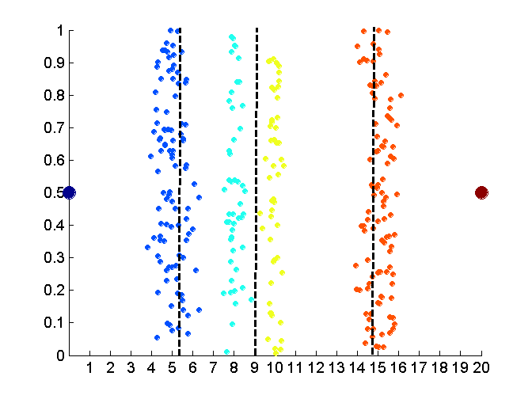
Unsupervised Discretization
Equal frequency approach used to obtain 4 values.

Slide 49
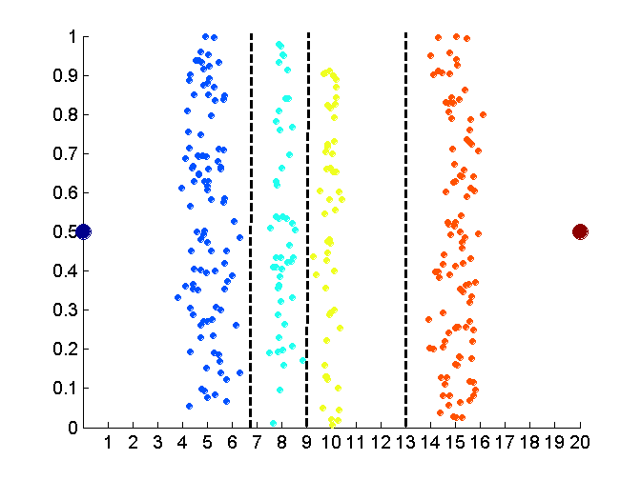
Unsupervised Discretization
K-means approach to obtain 4 values.

Slide 50
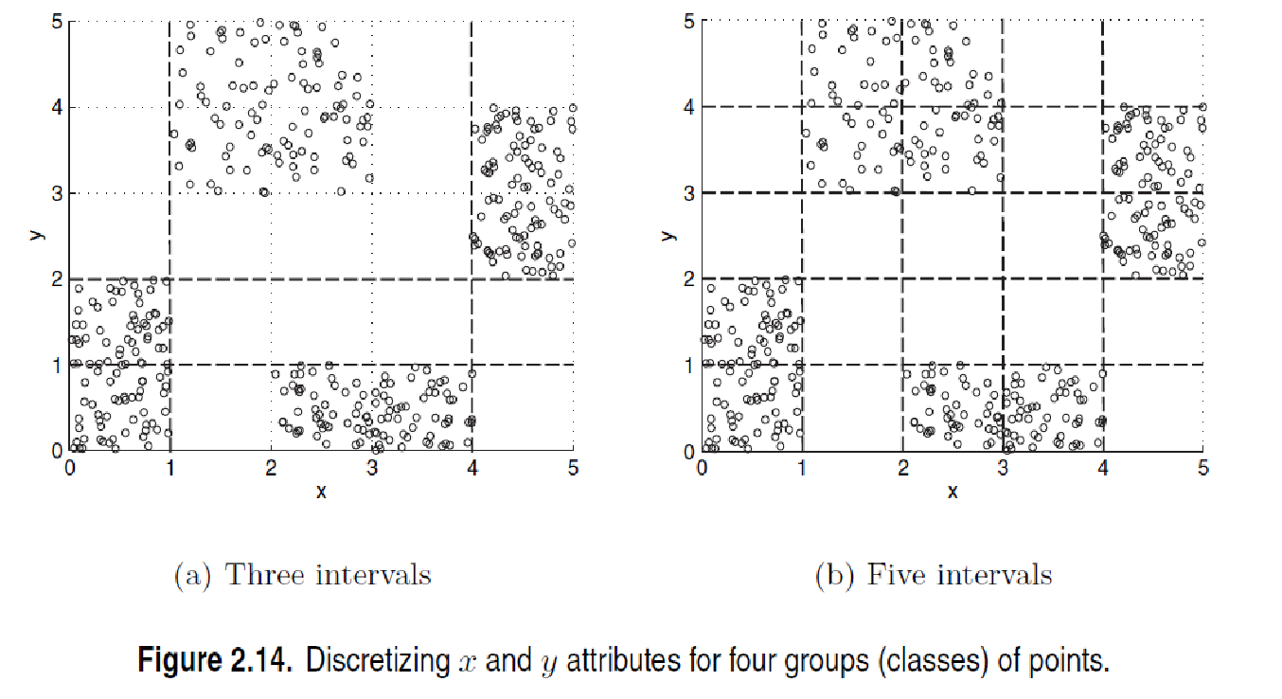
Discretization in Supervised Settings
Many classification algorithms work best if both the independent and dependent variables have only a few values
We give an illustration of the usefulness of discretization using the following example.

Slide 51
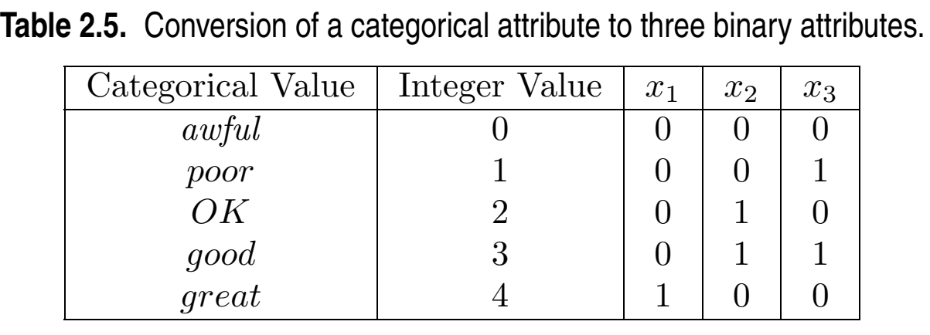
Binarization
Binarization maps a continuous or categorical attribute into one or more binary variables
Any Problem?

Slide 52
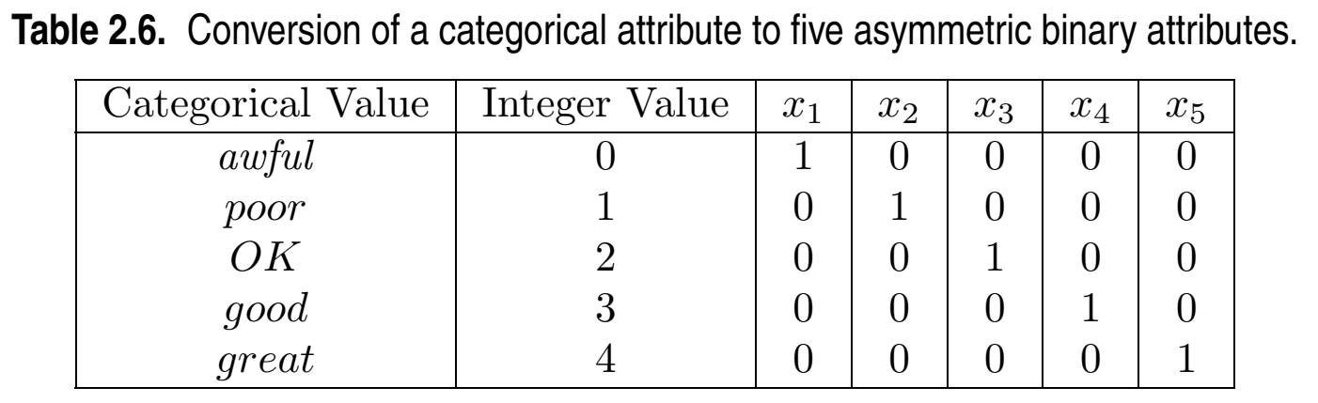
Binarization
Binarization maps a continuous or categorical attribute into one or more binary variables

Slide 53
Attribute Transformation
An attribute transform is a function that maps the entire set of values of a given attribute to a new set of replacement values such that each old value can be identified with one of the new values
Simple functions: x^{k}, log(x), e^{x}, |x|
Normalization
Refers to various techniques to adjust to differences among attributes in terms of frequency of occurrence, mean, variance, range
Take out unwanted, common signal, e.g., seasonality
In statistics, standardization refers to subtracting off the means and dividing by the standard deviation

Slide 54
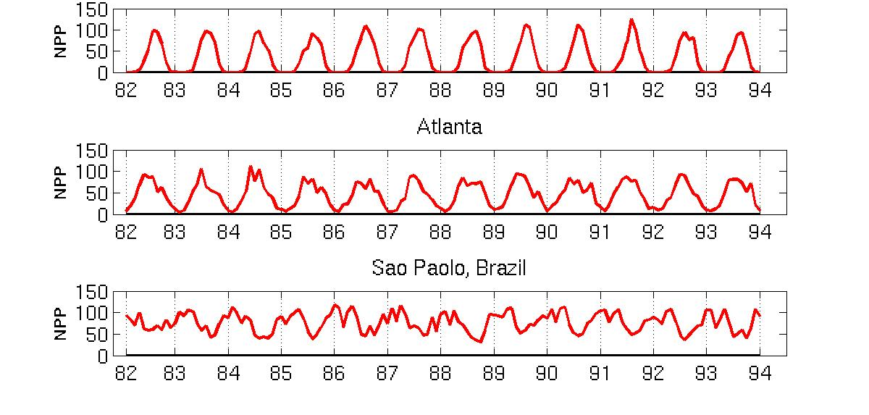
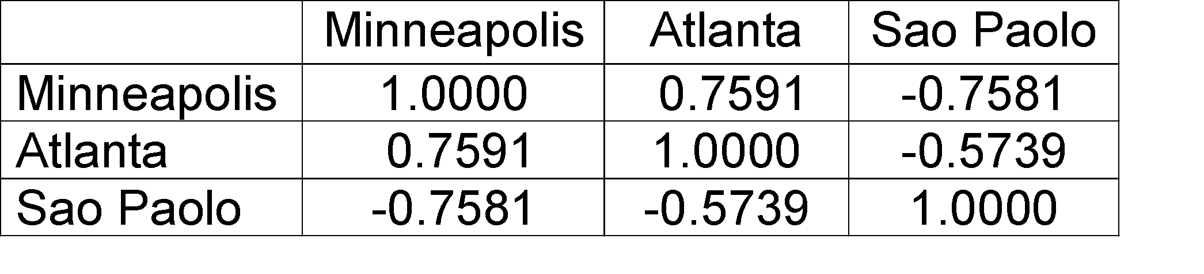
Example: Sample Time Series of Plant Growth
Minneapolis
Net Primary Production (NPP) is a measure of plant growth used by ecosystem scientists.
Correlations between time series
Correlations between time series

Slide 55
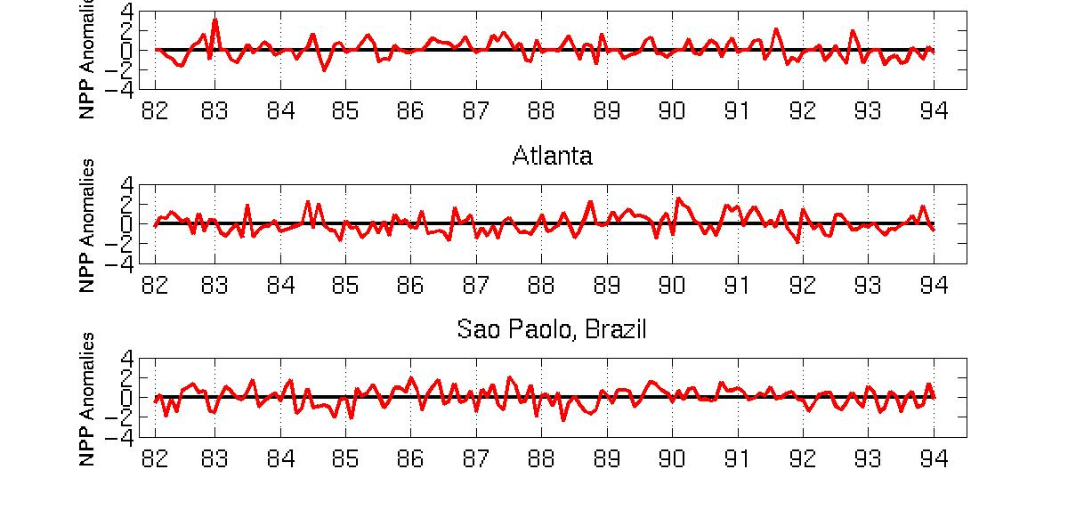
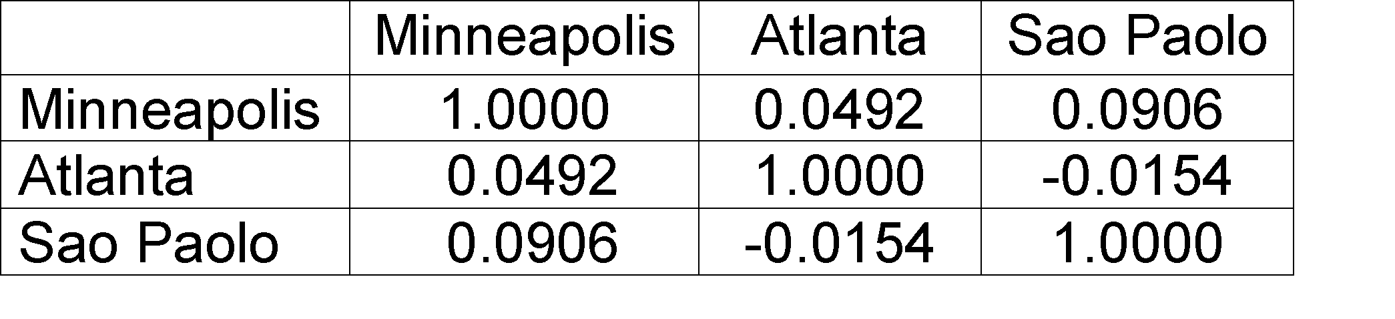
Seasonality Accounts for Much Correlation
Minneapolis
Normalized using monthly Z Score:
Subtract off monthly mean and divide by monthly standard deviation
Correlations between time series
Correlations between time series

Slide 56
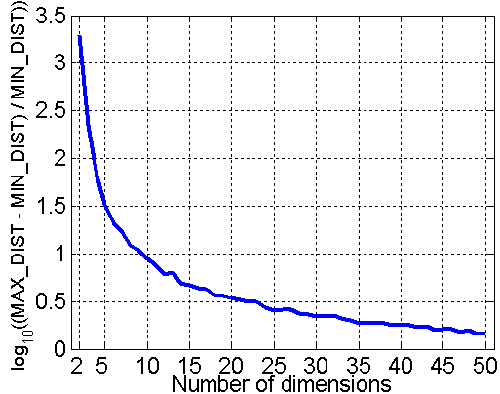
Curse of Dimensionality
When dimensionality increases, data becomes increasingly sparse in the space that it occupies
Definitions of density and distance between points, which are critical for clustering and outlier detection, become less meaningful
Randomly generate 500 points
Compute difference between max and min distance between any pair of points

Slide 57
Dimensionality Reduction
Purpose:
Avoid curse of dimensionality
Reduce amount of time and memory required by data mining algorithms
Allow data to be more easily visualized
May help to eliminate irrelevant features or reduce noise
Techniques
Principal Components Analysis (PCA)
Singular Value Decomposition
Others: supervised and non-linear techniques

Slide 58
Dimensionality Reduction: PCA
Principle of PCA is:-
Goal is to find a projection that captures the largest amount of variation in data
x₂
e
x₁

Slide 59
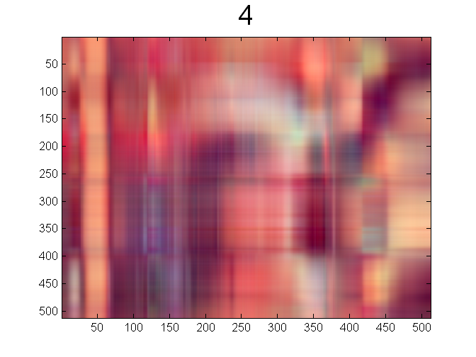
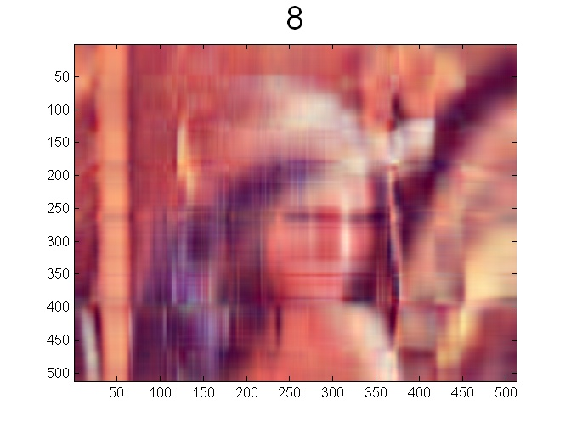


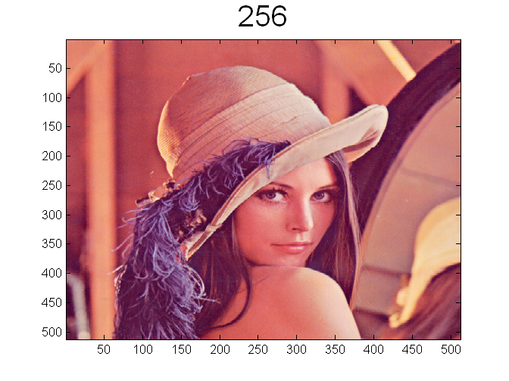
Dimensionality Reduction: PCA

Slide 60
Feature Subset Selection
Another way to reduce dimensionality of data
Redundant features
Duplicate much or all of the information contained in one or more other attributes
Example: purchase price of a product and the amount of sales tax paid
Irrelevant features
Contain no information that is useful for the data mining task at hand
Example: students' ID is often irrelevant to the task of predicting students' GPA
Many techniques developed, especially for classification

Slide 61
Feature Creation
Create new attributes that can capture the important information in a data set much more efficiently than the original attributes
Three general methodologies:
Feature extraction
Example: extracting edges from images
Feature construction
Example: dividing mass by volume to get density
Mapping data to new space
Example: Fourier and wavelet analysis

Slide 62
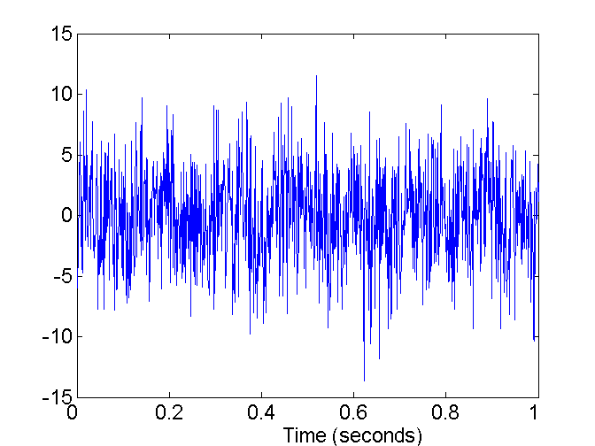
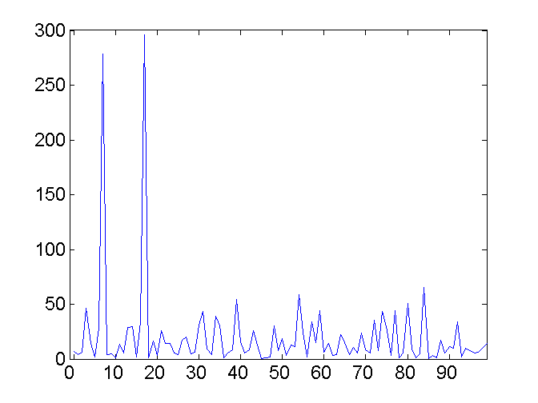
Mapping Data to a New Space
Fourier and wavelet transform
Frequency
Two Sine Waves + Noise
Frequency

Slide 63
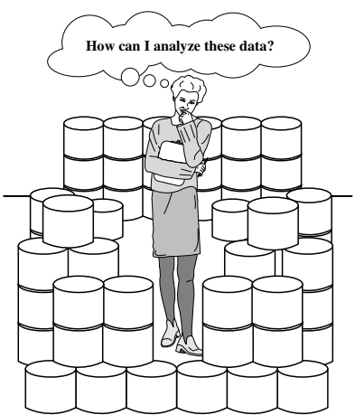
What is Data Mining?
Many Definitions
Non-trivial extraction of implicit, previously unknown and potentially useful information from data
Exploration & analysis, by automatic or semi-automatic means, of large quantities of data in order to discover meaningful
patterns

Slide 64
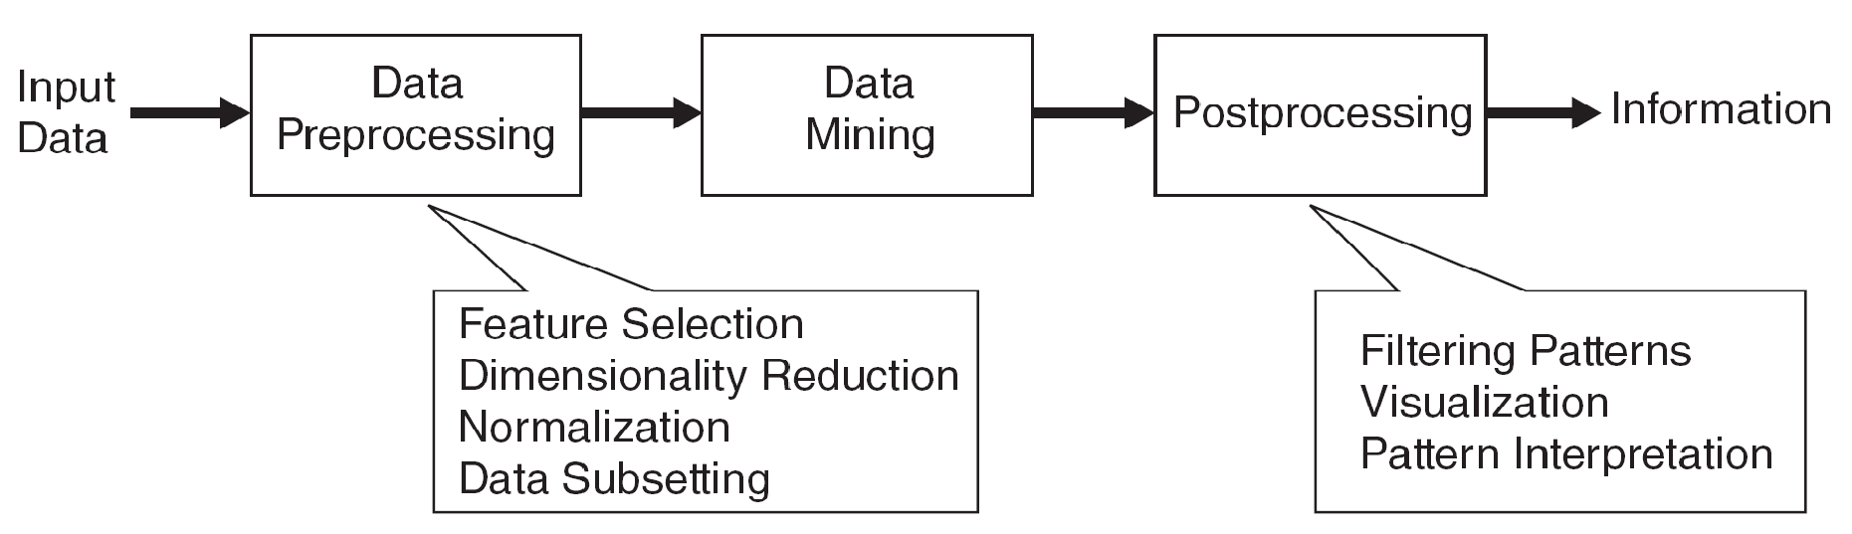
What is Data Mining?
Data mining is an integral part of knowledge discovery in databases (KDD), which is the overall process of converting raw data into useful information

Slide 65
What is Data Mining?
Input: variety of formats (flat files, spreadsheets, or relational tables) and may reside in a centralized data repository or be distributed across multiple sites
Preprocessing: transform the raw input data into an appropriate format for subsequent analysis.
Most laborious and time-consuming step
fusing data from multiple sources,
cleaning data to remove noise and duplicate observations,
and selecting records and features that are relevant to the data mining task at hand.

Slide 66
What is Data Mining?
Postprocessing: that ensures that only valid and useful results are incorporated into the decision support system.
For example, in business applications, the insights offered by data mining results can be integrated with campaign management tools so that effective marketing promotions can be conducted and tested.

Slide 67
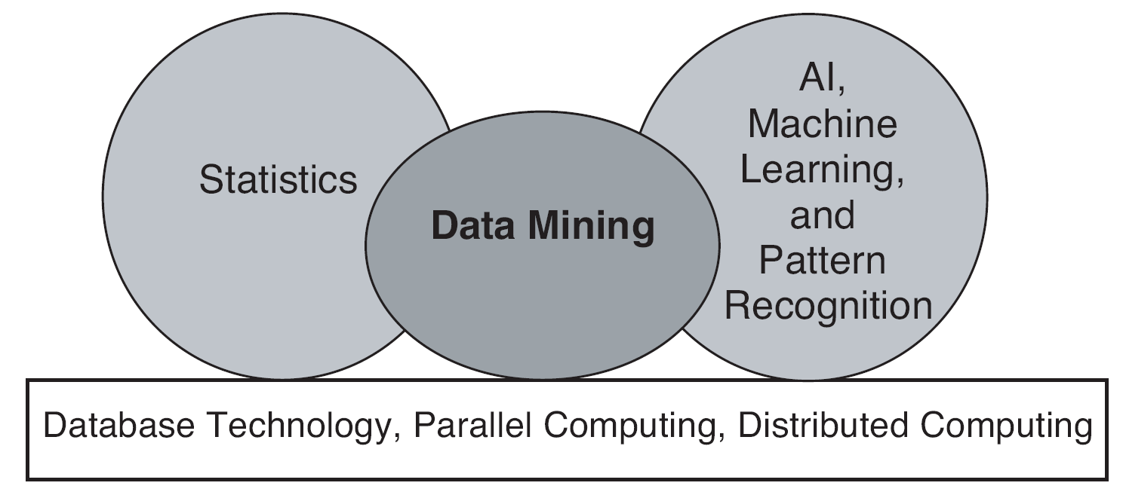
Origins of Data Mining
Draws ideas from machine learning/AI, pattern recognition, statistics, and database systems
A key component of the emerging field of data science and data-driven discovery

Slide 68
Data Mining Tasks
Prediction Methods
Use some variables to predict unknown or future values of other variables.
Examples?
Classification
Regression
Description Methods
Find human-interpretable patterns (correlations, trends, clusters, trajectories, and anomalies) that describe the data.
Example?
Association Discovery
Clustering

Slide 69

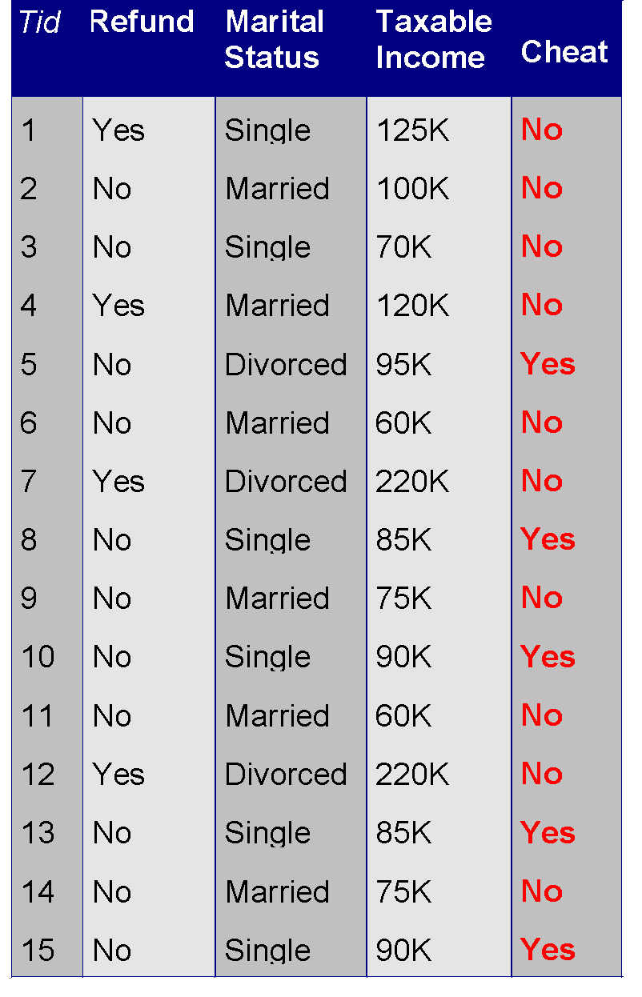


Data Mining Tasks …
Data
Clustering
Predictive Modeling
Anomaly Detection
Association Rules
Milk

Slide 70
Basic Data Mining Tasks
Classification maps data into predefined groups or classes
Supervised learning
The data (observations, measurements, etc.) are labeled with pre-defined classes. It is like that a “teacher” gives the classes (supervision).
Test data are classified into these classes too.
Regression is used to map a data item to a real valued prediction variable.
Supervised learning

Slide 71
Basic Data Mining Tasks
Clustering groups similar data together into clusters.
Unsupervised learning
Class labels of the data are unknown
Given a set of data, the task is to establish the existence of classes or clusters in the data
Summarization maps data into subsets with associated simple descriptions.
Extractive summarization
The main objective is to identify the significant sentences of the text and add them to the summary.

Slide 72
Basic Data Mining Tasks
Link Analysis uncovers relationships among data.
Affinity Analysis
Association Rules
Sequential Analysis determines sequential patterns.

Slide 73
References
Introduction to Data Mining, 2nd Edition Tan, Steinbach, Karpatne, Kumar
https://www.engr.uvic.ca/~seng474/introDM.ppt

